Slide 1
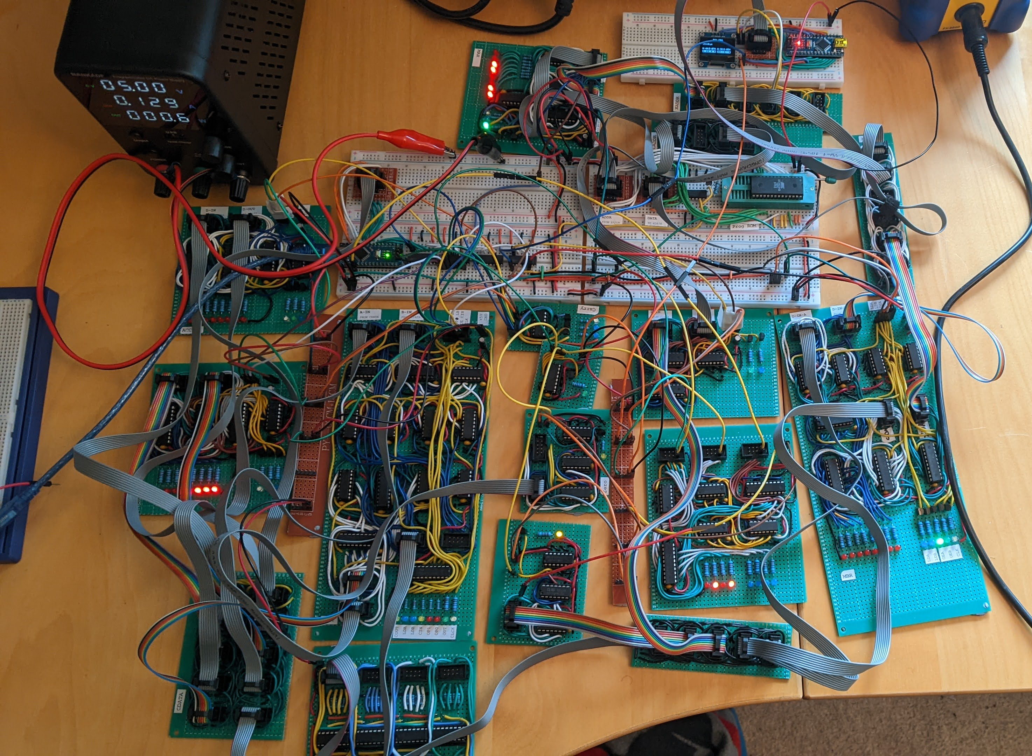
Memory Mapped Output
MAR
Control Unit
XADDR
CADDR
XDATA
Accumulator
Program ROM
ALU
X Register
Carry
Z Selection
Bus Bridge
Zero (ALU)
MBR
CDATA
P Register
Zero (CDATA)
CDATA
Debugging Display

